Slide 1
Vevox – Polling
Customer Success Guide

Slide 2
Suggestions for planning your questions
Invest time in creating your questions. Formulating interesting, creative and challenging questions does take time, avoid leaving this part of your presentation to the last minute.
Avoid Ambiguity. Ask a colleague to check the questions you have created, to make sure their meaning is clear.
Challenge your audience. Easy questions with obvious answers will not engage your audience as much as demanding ones that will make them think. By asking trivial or superficial questions you may actually cause offence to your audience.
Sometimes less is more. A small number of pertinent questions can be better received and enhance a presentation more than lots of questions. A large volume of questions can affect the flow of a presentation as there can be a tendency to race through them.
Embrace the grey areas. Sometimes the more interesting results are the ones given to questions that do not necessarily have a correct answer or what may be a predictable outcome.

Slide 3
Suggestions for planning your questions
Introduce it. Take the time to introduce the platform for polling and the polling process. Although the process for presenting and responding to polls is very simple, it is always worthwhile introducing the process and asking a warm-up question for the attendees to respond to.
Expect the unexpected. In preparation for your presentation, consider how you will respond to the audiences’ opinion gathering results. There may be some shocks in the results so rehearse how you may respond to possible outcomes. Embrace this, as this has the potential to make your presentation more interesting.
Comment on the results. Avoid any temptation to gloss over voting results with such phrases as “hmmm, interesting, next question please”. It is very important to comment on the results of the voting; audiences can get offended by a lack of feedback on their input.
Be flexible. It often comes as a surprise to presenters to know that their questions do not have to be pre-scripted. Ad-lib questions mean a generic/blank question can be asked at any time. Simply give a vocal prompt stating which of the templates you would like to use and it will appear on-screen. Verbally pose the question to the audience then prompt to open the vote. This normally works best with a yes/no, or a strongly agree through to strongly disagree format.
Be reactive. This ad-lib facility enables you to immediately react to questions or comments raised by your audience or results of other questions.

Slide 4
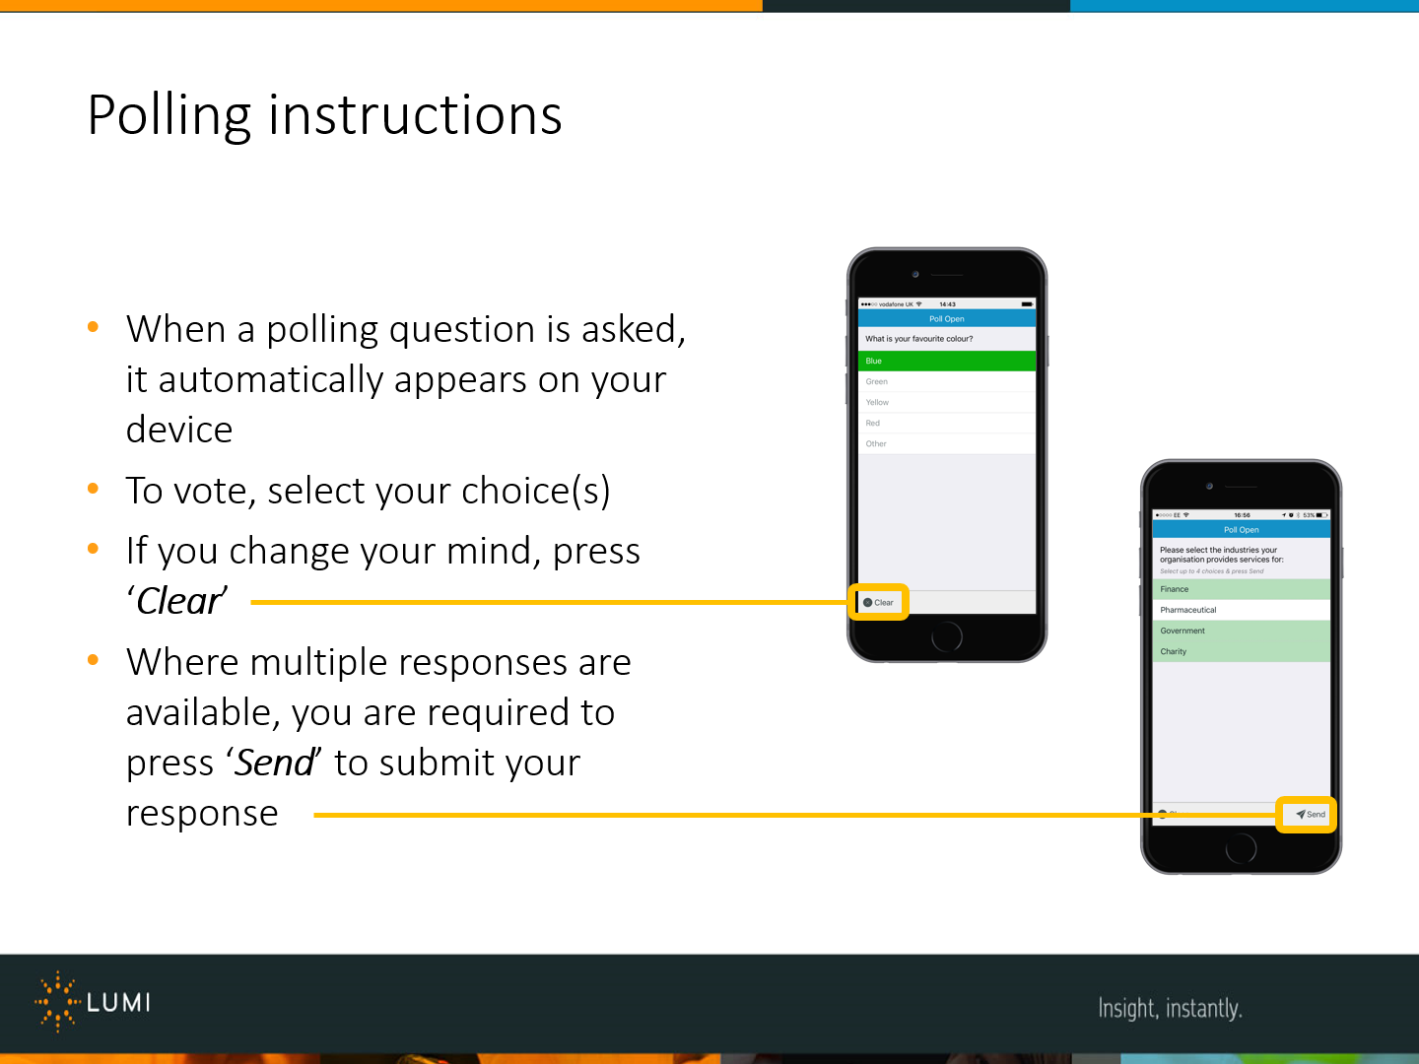
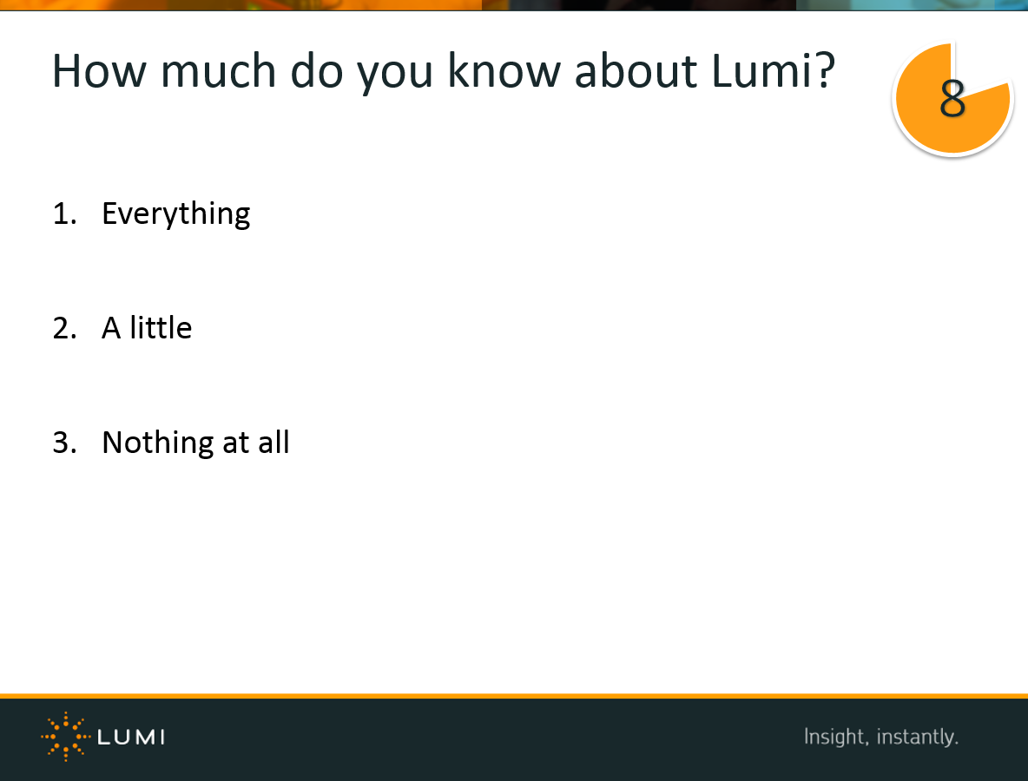
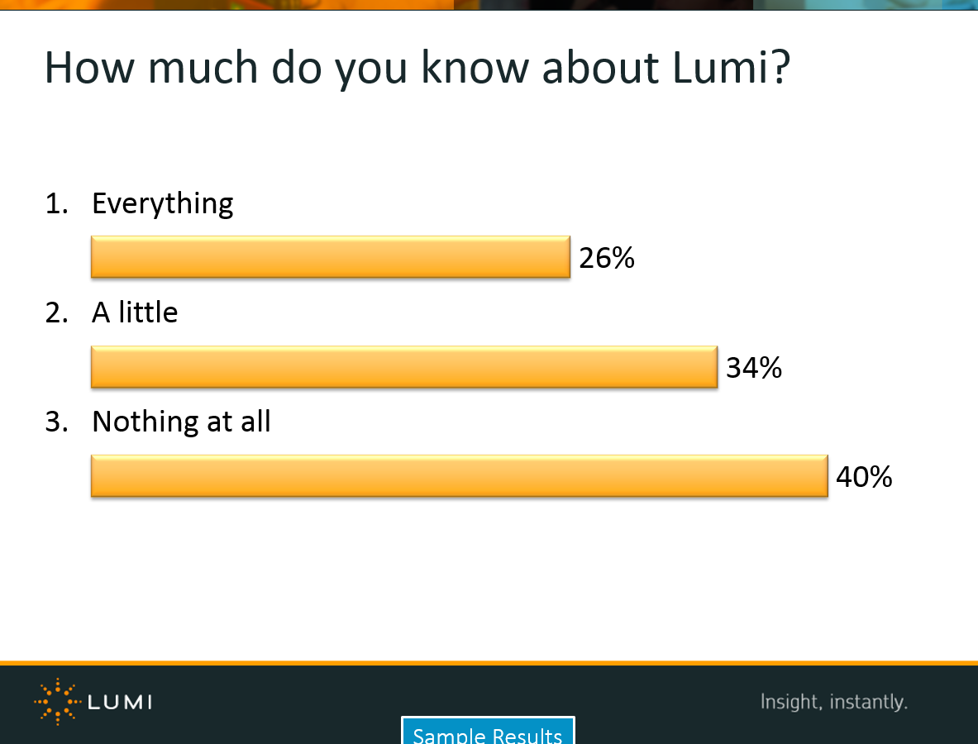
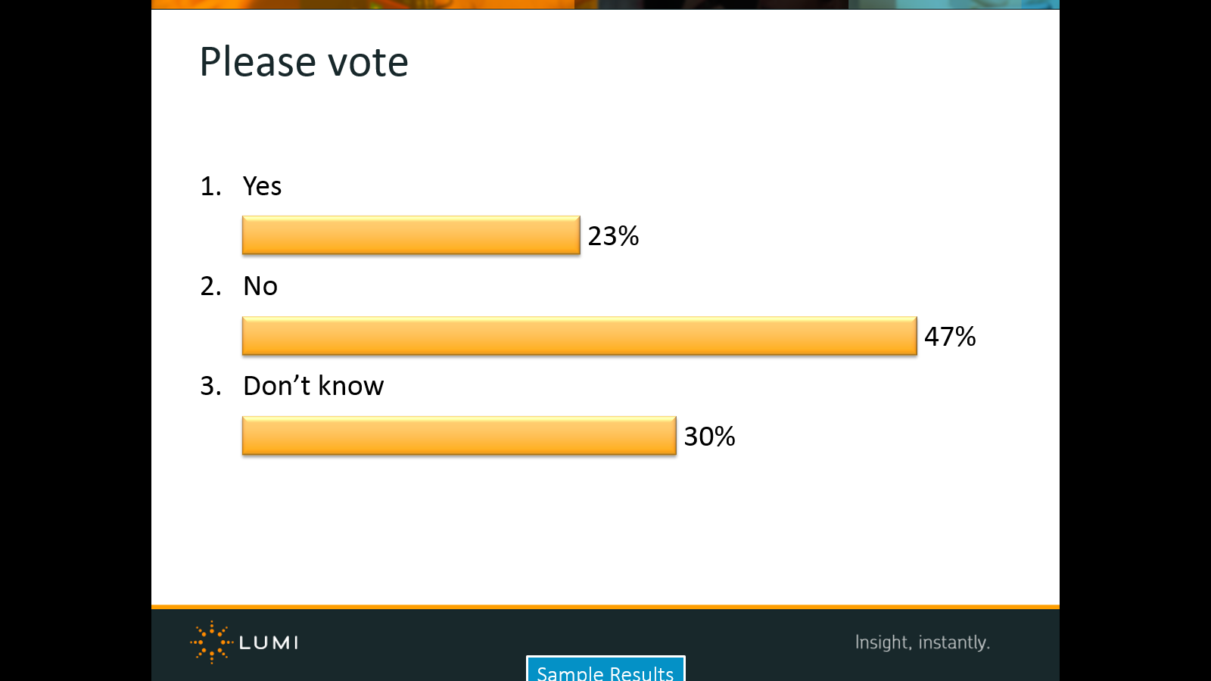
The polling process
Poll Open
The first time you poll your attendees, be sure to introduce the process with the help of an instruction slide. This will ensure your attendees know how to participate from the start.
Read the question, read the options/choices, then give the attendees a strong verbal cue to begin voting, eg. “vote now!”
Open the poll and wait for the responses to come in.
Close the poll to instantly reveal the results. (NB: you can set results to be hidden if you wish)

Slide 5
Test or Warm-up polls
It is always a good idea to run a test poll at the beginning of your meeting to ensure that all your attendees understand the polling process. Do not wait and risk low response rates on an important question. Get your attendees comfortable with responding to polls at the outset of your meeting when introducing Vevox as a tool for the meeting.
Test or warm-up questions do not need to be pointless or silly questions, however they should be easy for your attendees to answer, for example, a non-critical demographic question, industry related current affairs opinion poll, or perhaps a relatively serious business question that will set the tone for your meeting… but one that does not require 100% response. After a brief introduction and test or warm-up question, attendees are generally happy with how to respond and will participate more as a result.

Slide 6

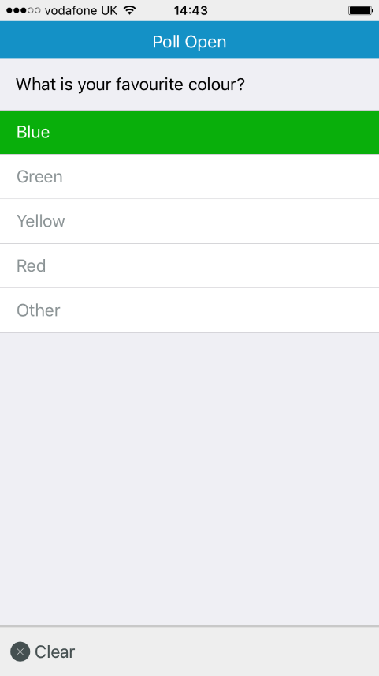
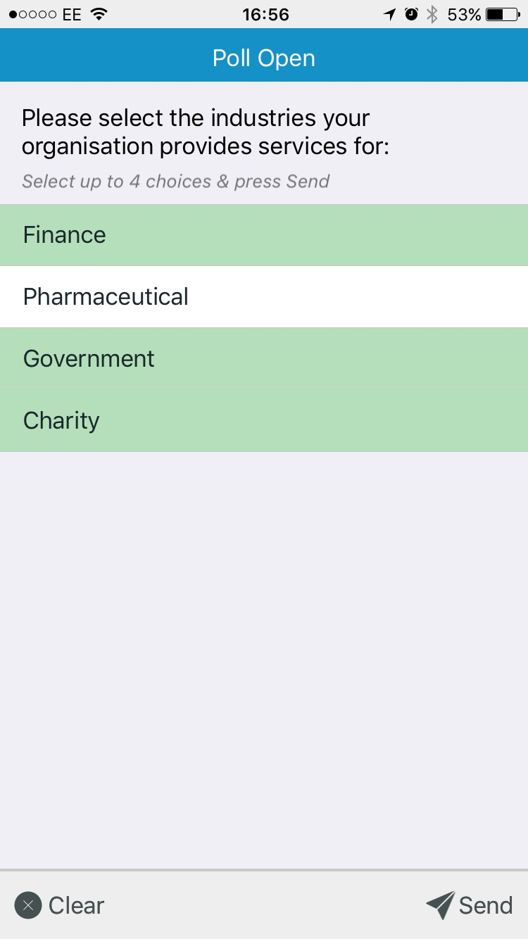
Example: Polling instructions
When a polling question is asked, it automatically appears on your device
To vote, select your choice(s)
If you change your mind, press ‘Clear’
Where multiple responses are available, you are required to press ‘Send’ to submit your response

Slide 7
Question formats
Vevox supports a variety of poll and analysis formats:
‘Single choice’ poll (choose one option from a list)
‘Multi choice’ poll (select a number of options from a list – maximum number of options is variable)
‘Comparison’ analysis (compare the results of up to 6 polls of the same question – eg ‘Before & After’ polls)
‘Recall’ analysis (recall the results of a poll – eg Reveal the results of a poll where results were hidden)
‘Total’ analysis (amalgamate the results from up to 6 polls of the same question)
The following slides are some examples how you can use Vevox polling.

Slide 8
Single choice polling

Slide 9
How much do you know about Vevox?
1.
Everything
46%
2.
A little
36%
3.
Nothing at all
18%
Notes:
Standard Polling Question with Results Bars

Slide 10
Multi choice polling

Slide 11
Which of the following sectors/industries does your organisation service? (select all that apply, then press ‘Send’)
Vote for up to 7 choices
1.
Financial
12.50%
2.
Pharmaceutical / Healthcare
12.50%
3.
Government
18.75%
4.
Charity
25%
5.
Energy
12.50%
6.
IT / Telecoms
6.25%
7.
Utilities
12.50%
(% = Percentage of Voters)

Slide 12
‘Comparison’ analysis

Slide 13
How well you understand the sales strategy for 2020?
1.
Not at all
24%
2.
A little
40%
3.
Fairly well
18%
4.
Completely
18%

Slide 14
How well you NOW understand the sales strategy for 2020?
1.
Not at all
32%
2.
A little
30%
3.
Fairly well
28%
4.
Completely
10%

Slide 15
How well you understand the sales strategy for 2020?
1.
Not at all
24%
32%
2.
A little
40%
30%
3.
Fairly well
18%
28%
4.
Completely
18%
10%
Before
Now

Slide 16
‘Recall’ analysis

Slide 17
Evaluation: Please rate the quality of the content
1.
Very Poor
2.
Poor
Data Captured
Thank You
3.
Good
4.
Excellent

Slide 18
Evaluation: Please rate the quality of the content
1.
Very Poor
24%
2.
Poor
40%
3.
Good
18%
4.
Excellent
18%

Slide 19
‘Total’ analysis

Slide 20
How well do you understand the sales strategy for 2016?
1.
Not at all
24%
2.
A little
28%
3.
Fairly well
22%
4.
Completely
26%
Group 1

Slide 21
How well do you understand the sales strategy for 2016?
1.
Not at all
11.90%
2.
A little
21.43%
3.
Fairly well
26.19%
4.
Completely
40.48%
Group 2

Slide 22
How well do you understand the sales strategy for 2016?
1.
Not at all
31.71%
2.
A little
29.27%
3.
Fairly well
24.39%
4.
Completely
14.63%
Group 3

Slide 23
How well do you understand the sales strategy for 2016?
1.
Not at all
34.04%
2.
A little
19.15%
3.
Fairly well
17.02%
4.
Completely
29.79%
Group 4

Slide 24
How well do you understand the sales strategy for 2016?
1.
Not at all
5%
2.
A little
46%
3.
Fairly well
1%
4.
Completely
48%
Group 5

Slide 25
How well do you understand the sales strategy for 2016?
1.
Not at all
27.51%
2.
A little
22.71%
3.
Fairly well
24.02%
4.
Completely
25.76%
Total amalgamation of Groups 1-5

Slide 26
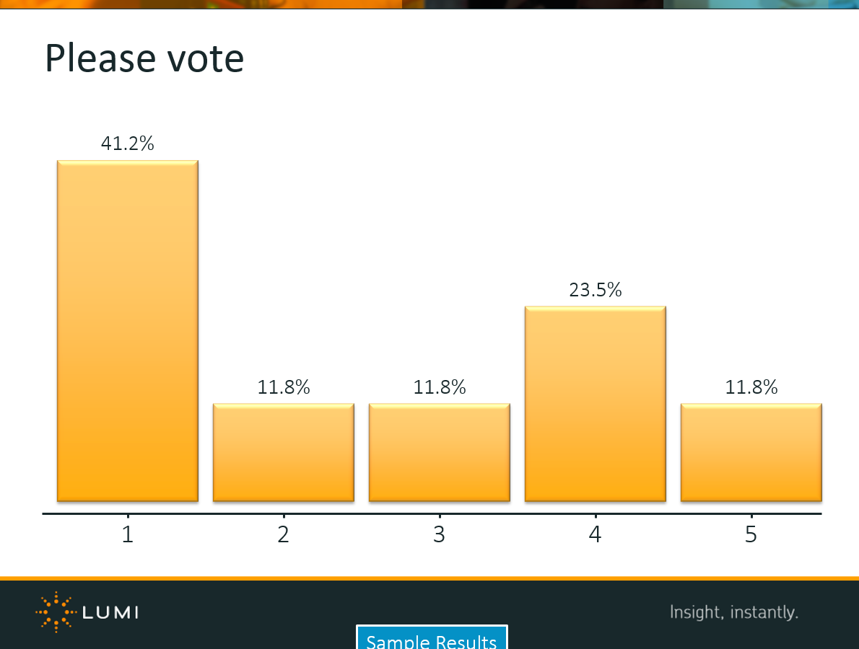
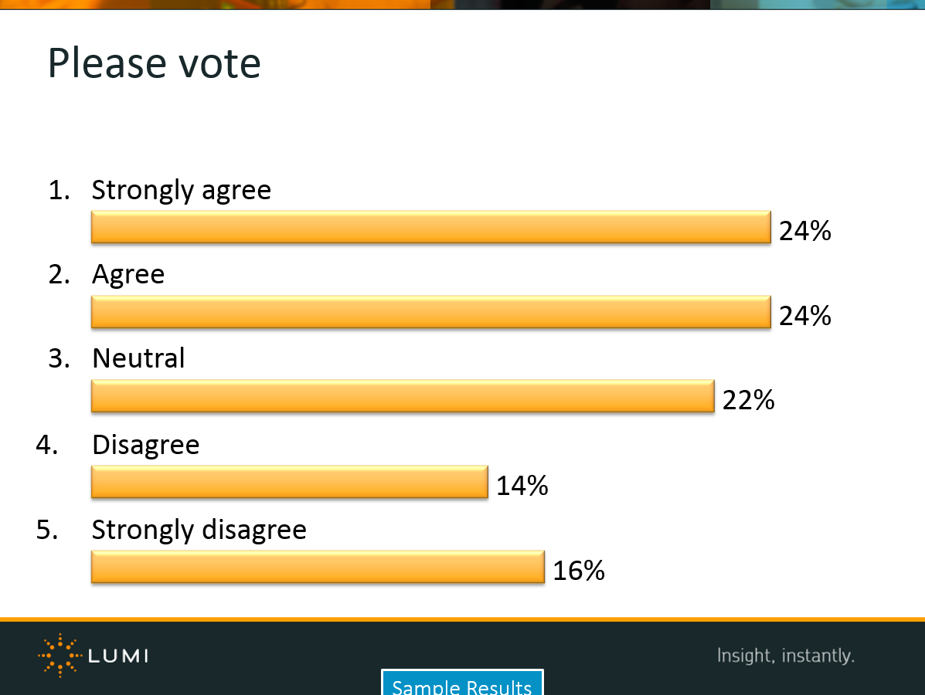
Questions on the fly
If you see a theme trending during your meeting or have a controversial or interesting question arise, put it to a vote instantly.

Slide 27
Using more interesting and creative polling slides
By using the Vevox PowerPoint add-in, you are able to format the polling question objects (option text/bars/labels) to create different question layouts (as seen on following slide).
Also, as the result bars are PowerPoint objects (rectangle for horizontal bars by default), you are able to alter the shape, size, border and fill to create the desired effect. You can also remove the bars altogether and just so the result data labels if you desire.

Slide 28
How well do you understand the sales strategy for 2020?
1.
Not at all
31.71%
2.
A little
29.27%
3.
Fairly well
24.39%
4.
Completely
14.63%

Slide 29






Where are you from?
1.
4
Mid-West
22%
2.
South-East
5
West
1
East
14%
20%
3.
South
2
3
South-East
South
20%
4.
Mid-West
24%
5.
West

Slide 30
Creating interesting custom result bars
Vevox Tutorial

Slide 31
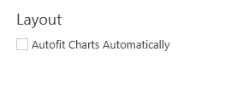

Creating custom result bars
Step 1.
Before starting, make sure Autofit Charts Automatically is off in the Vevox Add-in Preferences. You can then create your question and move the bars freely.

Slide 32

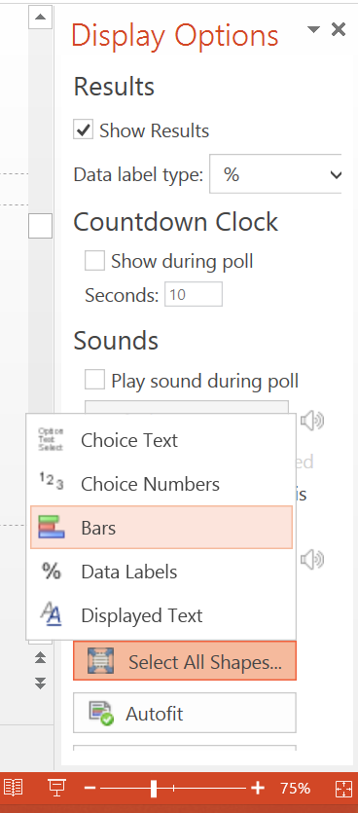
Creating custom result bars
Step 2.
After creating your question, go to:
Vevox add-in on your PowerPoint ribbon
Display Options
Select All Shapes
Bars

Slide 33
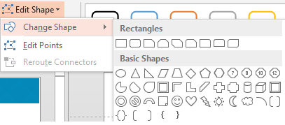
Creating custom result bars
Step 3.
Under the Format tab, click Edit Shape and select the shape you require.

Slide 34

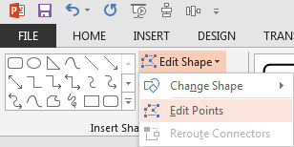
Creating custom result bars
Step 4.
In order to create an isosceles triangle (as in the following example), select each bar in turn and click Edit Points. You can then drag the point at the end of the triangle to create two equal sides.

Slide 35
Creating custom result bars
The following slides are examples of different result bar formats created using the technique described.
Try experimenting with different style to achieved your desired effect.
Be sure to test your polling questions thoroughly to ensure that each slide works as expected.
NB: Some shapes work better than others when being used as result bars

Slide 36
How are you feeling this morning?
1.
Great!
23%
2.
Ok
47%
3.
Been better
16%
4.
Awful.
14%
In this example, the bars have been moved together to overlap and made transparent.

Slide 37
How are you feeling this morning?
1.
Great!
16%
2.
Ok
26%
3.
Been better
20%
4.
Awful.
38%
Experiment by using different shapes and colours to create a more unique chart.

Slide 38
How are you feeling this morning?
1.
Great!
2.
Ok
3.
Been better
4.
Awful.
1.
2.
3.
4.
These bars have been rotated. Please note that the data labels do not function with this format, but the bars still provide a good visual representation.

Slide 39
Vevox – Polling
Customer Success Guide

